Slide 1
TRANSACTION MANAGEMENT

Slide 2
Transaction
Transaction is an interaction between different users or different systems or user and a system.

Slide 3
Transaction Defined as-
Collection of read and writes.
Also as a unit of program instruction that accesses and updates various data values.
Also as a set of statements between two commits or two rollbacks.
Read(select) and write(insert, update, delete)

Slide 4
Important Points
A transaction must always see a consistent database.
If the transaction is aborted then the database must be restored to its prior consistent state.
During transaction execution the database may be in an INCONSISTENT state but after the transaction its committed, it should always end with a consistent state.

Slide 5
Life Cycle of Transaction
Active(start)- Its the initial state which the transaction stays while being processed.
Partially Completed or Partially Committed - After the initial state a transaction proceeds to its normal execution.
Completed or committed - After the transaction ends in a normal way it is completed or committed. This is also termed as a successful transaction.
Failed state - After the initial state a transaction could end in a failed state, either by system error or few logical errors and cannot complete its normal execution.
Aborted(cancelled) - A failed transaction is normally aborted and aborted transaction has two options:
1)It is killed. 2)Rollback and restarted from the first(initial) step.

Slide 6
Properties of Transactions (ACID)
A (Atomicity) : Either all operation of the transaction are properly reflected in the database or none are.
C (Consistency) : Execution of a transaction must preserve the consistency of the database. Consistency states that prior to a transaction the database is in a consistent state and after the transaction complete the same stable state should be achieved.
I (Isolation) - Although multiple transaction may execute concurrently each transaction must be unaware of the other concurrently executing transaction. The intermediate results must be hidden from the rest of the transaction to ensure consistency.
D (durability) - After a transaction completes successfully the changes it has made to the database must persist even if there are major or minor failures.

Slide 7
Schedule
•A schedule is a set of transactions which consists of many instructions with a said order.
•It is also defined as a collection of many transactions.
•Schedule is classified into serial and non‐serial schedule.
•Serial schedule: one transaction is completed and then other transaction taken up consecutively.
•Non serial schedule: one transaction is interleaved with the rest of transaction in the schedule.

Slide 8
Concurrency
• When transactions are interleaved with one another during execution the process is termed as concurrency and the transaction is termed as concurrent transaction.
• Concurrency increases optimal use of resources and throughput of the system and ultimately the efficiency of the system.
Concurrency : When several transactions execute concurrently in the database on the same set of records at the same timestamp.

Slide 9
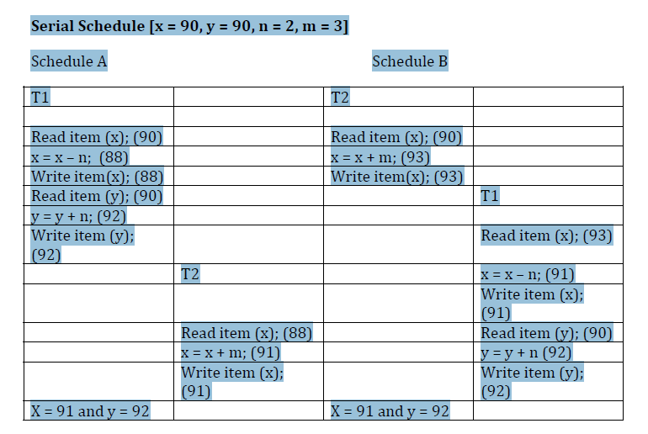

Slide 10
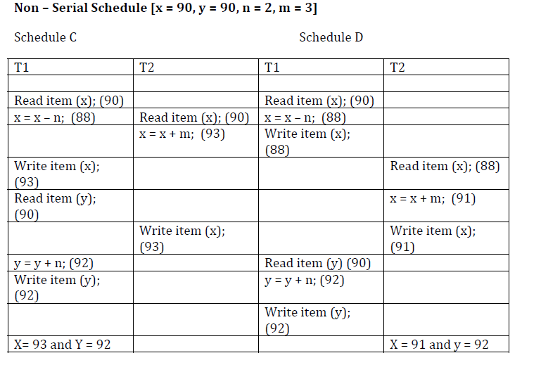

Slide 11
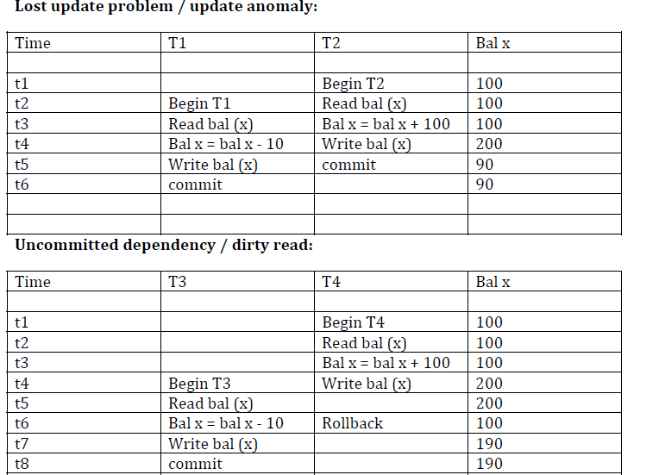

Slide 12
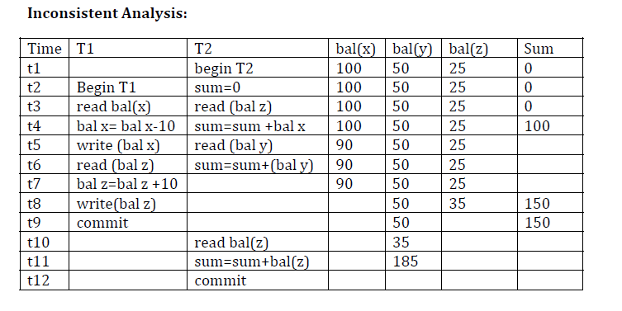
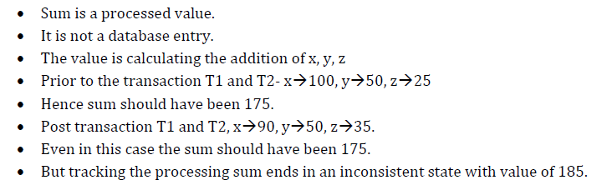

Slide 13
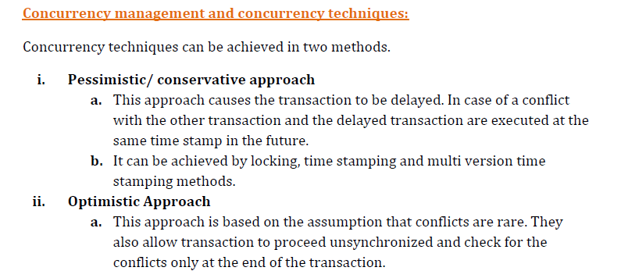

Slide 14
Locking
• It is the procedure used to control concurrent access to the database values.
• When 1 transaction is accessing a database value a lock may deny access to other concurrent transactions in order to prevent incorrect results
Types of locking
Shared/ Read lock
If the transaction demands a shared lock on database values it can read database values but cannot update or delete.
Exclusive/ Write lock:
When a transaction has an exclusive lock on the database values
it can read, update, delete database values
.

Slide 15
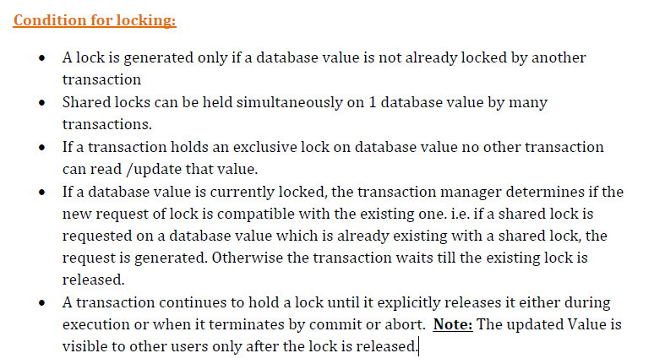

Slide 16

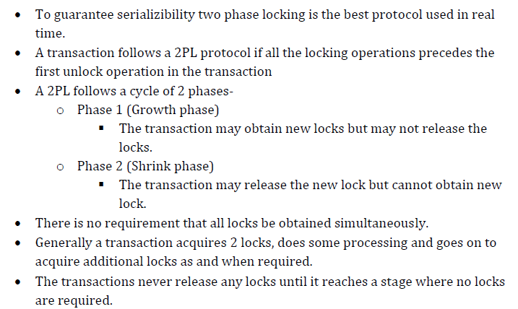

Slide 17
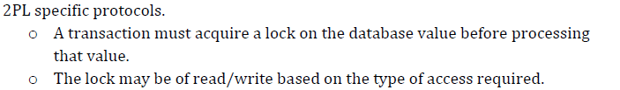
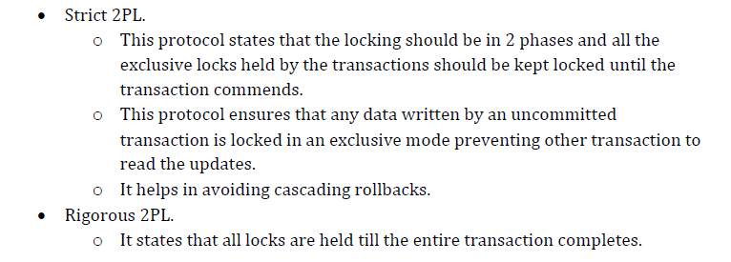
2PL Protocol:

Slide 18
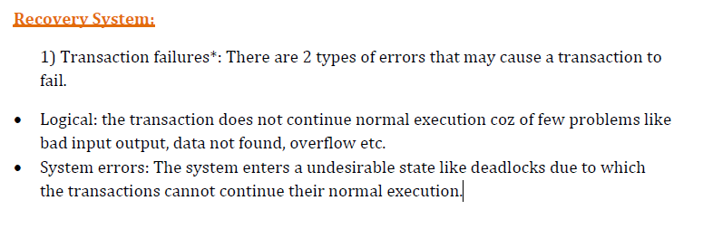

Slide 19
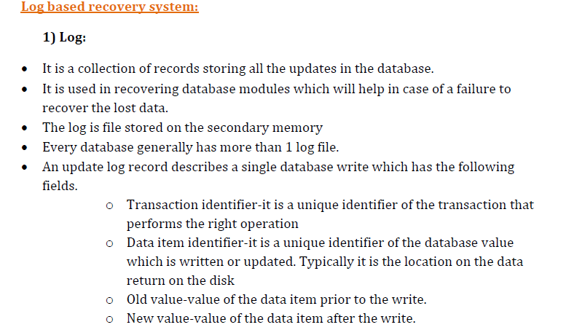

Slide 20
